Slide 1
Cloud-Assisted Trajectory Data Management and Analysis: A Case Study
Department of Computer Science, Tsinghua University
Xiang Lan
2017.12.12
Notes:
Hello, every one. I’m Xiang Lan from Tsinghua University. Our paper is Cloud-Assisted Trajectory Data Management and Analysis: A Case Study.

Slide 2
Contents
Background and Challenges
Cloud-assisted Framework: TrajMan
Case Study: Commute Behavior Analysis
Experiments and Evaluation
Conclusion and Future Work
Notes:
I’ll first introduce the background and challenges, and then propose the cloud-assisted framework: TrajMan. A case study on commute behavior analysis is then given. After that, I’ll show the experimental results. Finally comes the conclusion.

Slide 3
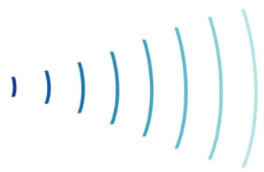

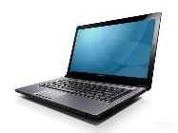
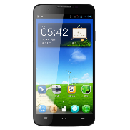
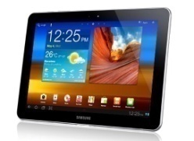
Background
Massive trajectory data are generated every day
Lots of applications can be done based on the data
traffic prediction, urban planning, personalized recommendation
Vehicles
Laptops
Tablets
Mobile phones
Notes:
As smart ubiquitous devices get more and more popular, massive trajectory data are generated every day. Lots of applications can be done based on these data. For example, traffic prediction, urban planning, personalized recommendation, etc.

Slide 4


Challenges
One user may have multiple devices
Different data source, different precision and frequency
Duplication costs bandwidth
Data scarcity for a single trajectory
What should be transmitted?
Cloud Server
Few points on a trajectory..
Notes:
Dealing with the trajectory data, we usually meet the following challenges:
One user may have multiple devices and each device generates some positioning data. The precision and frequency of the data generated by different devices may vary. Also, duplication exists since all the devices may generate positioning data at the same time. So, here is the question, what data should be transmitted to the cloud server?
Besides, due to the irregularity and randomness of the usage of location based service, we meet data scarcity problem when we want to perform further trajectory analysis. The points on a certain trajectory are too few, may be just 3 or 4 points. Data interpolation must be done if we want more precise results.

Slide 5
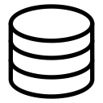


Cloud-assisted Framework: TrajMan
Clients
Open feature API
Cloud
servers
Features
Laptops
Feature mining
Augmented data
Data interpolation
Trajectories
Phones
Trajectory recognition
Positioning data
Tablets
Edge devices & servers
Compressed data
Data compression
Wearables
Calibrated data
Positioning calibration
Raw data
Data preprocessing
Vehicles
Wireless
routers
Cell
towers
Position sensing
Positioning data
Notes:
We propose TrajMan, the Cloud-assisted Framework for Trajetory Data Management and Analysis. TrajMan inserts an Edge layer between clients and the cloud server.
The edge layer consists of edge devices such as wireless routers and cell towers. They do some data preprocessing work including anomaly elimination, and calibrate user’s position with the data collected from different sources. The edge layer makes the best estimation of the user’s location based on the collected data and compress them before sending them to the cloud servers.
The cloud server will first recognize trajectories and perform data interpolation by merging similar trajectories. Then, it can do the feature mining and make open APIs for these mined features to other applications.

Slide 6
Case Study: Commute Analysis
Data Collection
Android app & Web app
88 volunteers, in 5 cities
Each participates in the project for 1 week to 1 month
601 person-days in total
Online survey for validation
Home/company location
Commute time/distance
…
Notes:
We conducted a case study on commute behavior analysis to show the effectiveness of our framework.
We developed two versions of apps: the Android app and the web app. We enrolled 88 volunteers in 5 cities. Each volunteer participates in the project for 1 week to 1 month, and there are 601 person-days in total.
We also developed a web page for online survey. The questions include the user’s home/company location, their commute time and distance, etc.

Slide 7
Case Study: Commute Analysis
Data Preprocessing on the Edge Servers
Eliminate data with too much deviation
Merge data from different sources, and choose the one with highest accuracy
Calibrate positions with spatiotemporal adjacent points
Resample and compress data before transmitting them to the cloud server
Notes:
All the positioning data are first sent to the edge servers. The edge servers will first eliminate data with too much deviation, then merge data from different sources and choose the one with highest accuracy. After that, the edge servers will calibrate the user’s position with spatiotemporal adjacent points. The edge servers would then resample and compress the data before transmitting them to the cloud server

Slide 8
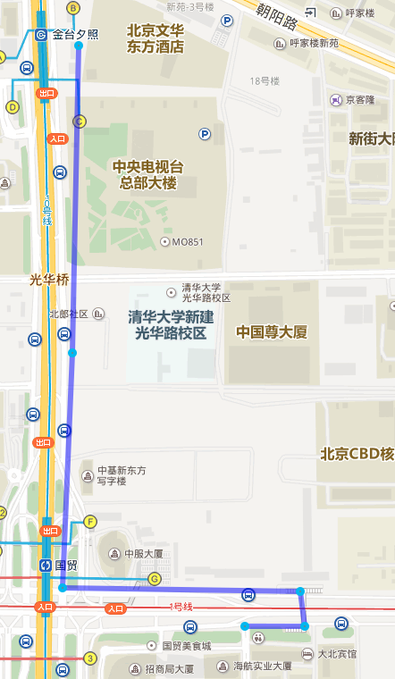
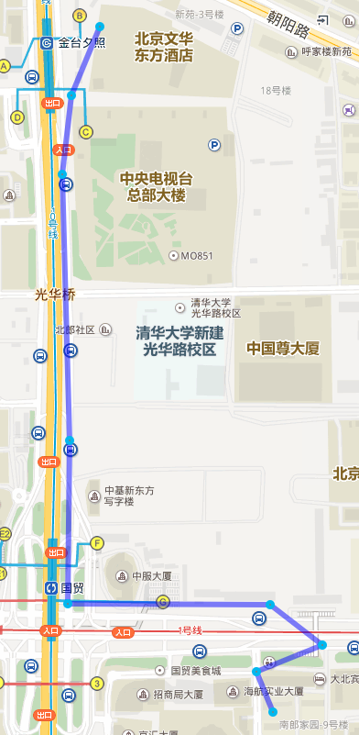
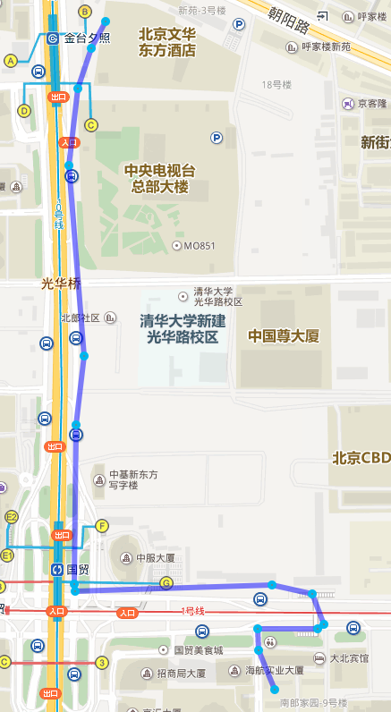
Case Study: Commute Analysis
Similar Commute Trajectory Clustering (SCTC) on the Cloud
Keep the topological order of points
Merge trajectories in both spatial and temporal dimensions
Day-1
60s
Day-2
20s
Merged
42s
40s
51s
280s
61s
70s
31s
120s
50s
63s
Notes:
We found that each collected trajectory may only contain 5~10 points, which is too few for precise feature mining. Due to the regularity of the user’s commute behavior, we can merge similar commute trajectories. There are two features of our algorithm:
Our algorithm keeps the points’ topological order in the merged trajectory the same as that in their original trajectory
We merge the trajectories in both spatial and temporal dimensions.
The left and middle picture show the user’s commute trajectories on two certain days, and the right one is the merged trajectory. We calculate the travelling time between two adjacent points based on the distance.

Slide 9
Case Study: Commute Analysis
Feature Analysis
commute distance: the corresponding merged trajectory’s length
departure/arrival time:
Calculate the average velocity
commute time
Merged
Notes:
After we merge all the similar trajectories, for a certain commute trajectory, we can calculate the length of the corresponding merged trajectory as the commute distance.
In terms of the departure/arrival time, we can first calculate the average velocity of the trajectory and estimate the time with it.
The commute time can be calculated as the difference between arrival time and departure time.

Slide 10
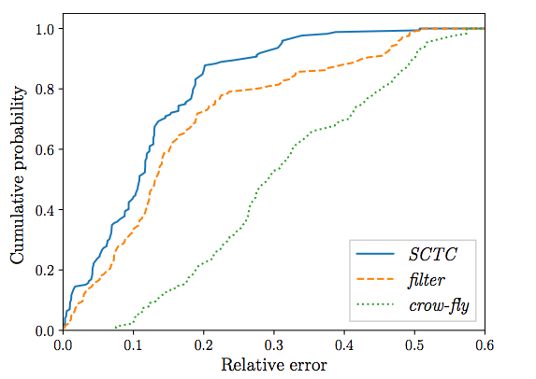
Experiments and Evaluation
Commute Distance
filter: without merging similar trajectories
crow-fly: geographic distance between user’s home and company
CDF of relative distance deviation
Notes:
We compare our merging algorithm with other methods.
Filter is a widely-used algorithm, which just filters all the points on the trajectory, and calculate the length of the trajectory as the commute distance.
The crow-fly algorithm makes a even more coarse estimation, it takes the geo-graphic distance between the user’s home and company.
We can see from the picture that crow-fly algorithm is the lower bound of the commute distance estimation, and the merged algorithm has the highest accuracy since it obtains a more precise trajectory by merging all similar trajectories.

Slide 11
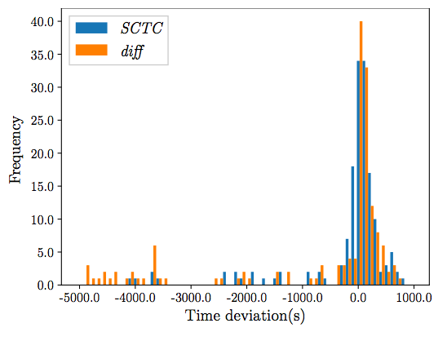
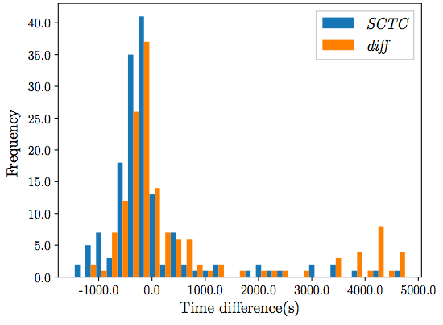
Experiments and Evaluation
Commute Time
diff: time difference between the timestamp of the last at-home point and first at-company point
Frequency of departure time deviation
Frequency of commute time deviation
Notes:
Diff algorithm takes the time difference between the timestamp of the last at-home point and the first at-company point as the commute time. Users may stay at home for a while after they use the location based service, therefore it’s inaccurate to take the timestamp of the last at-home point as the departure time. As we see from the picture, diff has an earlier departure time estimation, and thus has longer calculated commute time.

Slide 12
Experiments and Evaluation
Resource Saving
In real dataset of the case study, TrajMan save 66.89% of the data through preprocessing, anomaly elimination and deduplication
Saved around 31 minutes computation on average in the mobile devices for feature analysis
Notes:
TrajMan has another advantage: resource saving.
In real dataset of the case study, TrajMan save 66.89% of the data through preprocessing, anomaly elimination and deduplication.
Since all the feature mining are conducted on the cloud servers, TrajMan saves around 31 minutes computation on average in the mobile devices for feature analysis

Slide 13
Conclusion and Future Work
TrajMan: a cloud-assisted framework for trajectory data management and analysis
Separation of edge server and cloud server:
edge server: anomaly elimination, deduplication, calibration, resampling and compression
cloud server: home/company identification, trajectory recognition and clustering, feature analysis
Will deploy more in China Telecom
More apps will be developed based on the captured features, e.g., traffic prediction, etc.
Notes:
Let’s make a conclusion. We proposed TrajMan, a cloud-assisted framework for trajectory data management and analysis.
It makes a separation of edge server and cloud server. The edge server performs anomaly elimination, deduplication and data calibration. It also resamples and compresses the data before sending them to the cloud server. The cloud server will first identify user’s home and company, recognize the user’s daily trajectory, merging similar trajectories and mines features based on the merged trajectory.
In the future, we will make a massive deployment in China Telecom, one of the biggest ISPs in China. More applications will be developed based on the captured features. For example, traffic prediction, personalized recommendation, etc.

Slide 14
Q & A
Notes:
Any question is welcome.

Slide 15
Thanks
lanx15@mails.tsinghua.edu.cn
Notes:
Thanks a lot.

